Slide 1
ALGORITHM & COMPLEXITY
INTRODUCTION
Course Lecturer: Prof Dr Abd Samad Hasan Basari
Address: FSKTM, 5th floor, Room No. 8
Email: abdsamad@uthm.edu.my
HP: 012-7158475
Course Code: BIE 20303

Slide 2
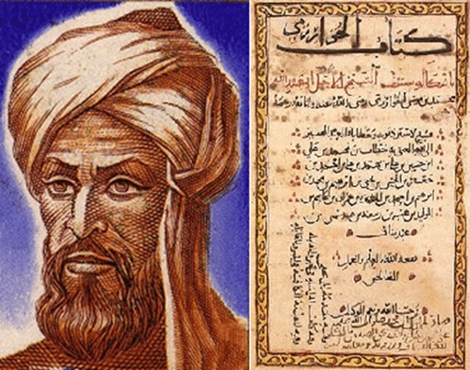
Algorithm: An Introduction
What is an Algorithm?
An algorithm is a sequence of unambiguous instructions or a finite set of steps for solving a problem, i.e., for obtaining a required output for any legitimate input in a finite amount of time.
Historical Perspective
Muhammad ibn Musa al-Khwarizmi
https://youtu.be/oyhOlGsDXP8?si=UoWdCNxsxnAxAX5o
9th century
Mathematician
https://en.wikipedia.org/wiki/
Muhammad_Ibn_Musa_Al-Khwarizmi
Notes:
We have algorithm, pesodo code and source code. What is the deference between them. Algorithm is a high level textual description, PC is a skeleton of code SC is a complete program to solve a particular problem
In his book treatise on algebra he presented the first systematic solution of linear and quadratic equations
his textbook on arithmetic has been translated to many languages including English and Latian

Slide 3
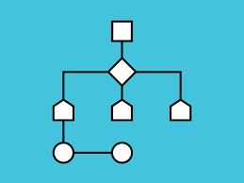
Algorithm: An Introduction
Why study algorithms?
Theoretical importance
The core of computer science
Watch this:
https://youtu.be/kM9ASKAni_s?si=uzk7luM0IJxxUWkD
Practical importance
A practitioner’s toolkit of known algorithms
Framework for designing and analyzing algorithms for new problems

Slide 4
Algorithm: An Introduction
The Notion of Algorithms
problem
algorithm
COMPUTER
input
output
Algorithmic Solution

Slide 5
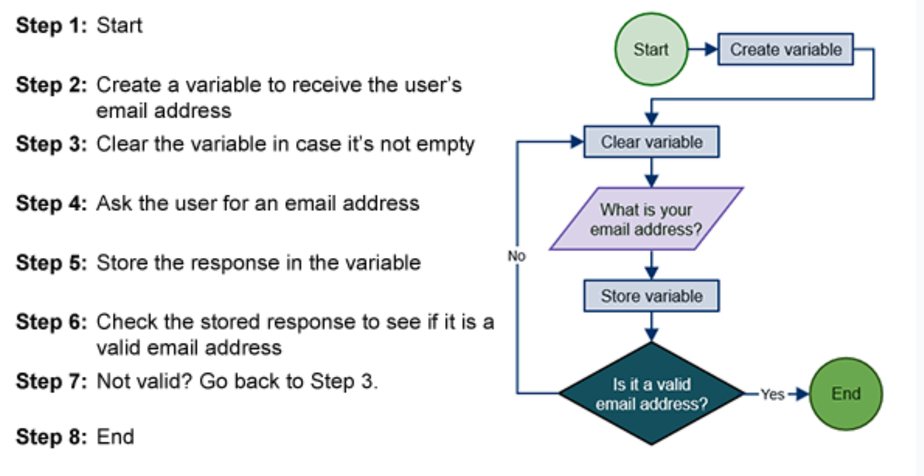
Algorithm: An Introduction
Simple algorithm of saving email address

Slide 6
Algorithm: An Introduction
Finiteness
Properties of algorithms
Finiteness
Terminates after a finite number of steps
Definiteness (Certainty)
Carefully and unambiguously specified
Input
Valid inputs are clearly specified
Output
Can be proved to produce the correct output given a valid input
Effectiveness
Steps are sufficiently simple and basic
Effectiveness
Algorithm
Definiteness
Input
Output

Slide 7
Algorithm: An Introduction
Greatest Common Divisor (GCD) Example
The largest positive integer that divides two integers
Example is the GCD of 8 and 12 is 4
Write an algorithm to find the Greatest Common Divisor (GCD) of two numbers
step 1 : get two numbers m and n (input)
step 2 : divide m by n
step 3 : if the remainder is 0 then return n as the GCD (output)
else
m ← n, n ← remainder
Goto step 2.
Definiteness
The above algorithm satisfies all the properties except definiteness, because what will happen if m = -5 and n = 7.28
So, change step 1 as “Get two positive non-zero integers m and n”
m n r
12 8 4
8 4 0

Slide 8
Algorithm: An Introduction
Algorithms’ Life Cycle
Design phase: Help in planning the algorithms. Some techniques are brute force, divide-and-conquer, Greedy, Dynamic programming, etc.
Write phase: Using natural language to write the algorithm and then implementing it in pseudo-code, which will be later represented in an appropriate programming language.
Test phase: Testing the algorithm for its correctness
Analyze phase: Estimating the amount of space/ time required while executing the algorithm.

Slide 9

Algorithm: An Introduction
Algorithms’ Design Strategies
Brute force
Divide and conquer
Decrease and conquer
Transform and conquer
Greedy Approach
Dynamic Programming
Backtracking and branch and Bound
Space and Time Tradeoffs
How to design algorithms?
How to express algorithms?
How to prove its correctness
How to prove its efficiency?
Theoretical analysis
Empirical analysis
How to prove its optimality?

Slide 10
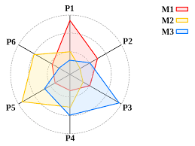
Algorithm: An Introduction
Analysis of Algorithms
Analysis refers to predicting the resources required by the algorithm, based on the size of the problem
Forecasting time complexity of the algorithm
Analysis based on time taken to execute the algorithm
Forecasting space complexity of the algorithm
Analysis based on the memory required to execute the algorithm
Usually, there is a tradeoff between time and space complexity,
more memory space means less time to execute and vice versa
How good is the algorithm?
Correctness
Time efficiency
Space efficiency
Does there exist a better algorithm?
Lower bounds (less cost)
Optimality
IS THIS ALGORITHM GOOD ?
IF YES THEN
SHOW THE PROVE
ELSE
ALSO SHOW THE PROVE

Slide 11
Algorithm: An Introduction
Analysis of Algorithms, GCD Example
Different algorithms can achieve a particular task
function gcd(a, b)
if a = 0
return b
while b ≠ 0
if a > b
a := a − b
else
b := b − a
return a
end function
(c)
(a)
function gcd(a, b)
if b = 0
return a
else
return gcd(b, a mod b)
end function
function gcd(a, b)
while b ≠ 0
t := b
b := a mod b
a := t
return a
end function
(b)
the remainder calculation (b = a mod b) is replaced by repeated subtraction

Slide 12
Algorithm: An Introduction
Algorithms for computational problems
Sorting
Searching
Shortest paths in a graph
Minimum spanning tree
Primality testing
Traveling salesman problem
Knapsack problem
Chess
Towers of Hanoi
Program termination

Slide 13
Algorithm: An Introduction
Algorithms for computational problems
Sort Example
Statement of problem
Input: A sequence of n numbers <a₁, a₂, …, a_{n}>
Output: A reordering of the input sequence <a´₁, a´₂, …, a´_{n}> so that a´_{i} ≤ a´_{j} whenever i < j
Instance: The sequence <7, 4, 5, 8, 2, 6>
Sort Algorithms
Selection sort
Insertion sort
Merge sort
Many others
Input: array a[1],…,a[n]
Output: array a sorted in non-decreasing order
Algorithm:
for i=1 to n
swap a[i] with smallest of a[i],…a[n]

Slide 14
Algorithm: An Introduction
void quicksort(int x[10],int first,int last){
int pivot,j,temp,i;
if(first<last){
pivot=first;
i=first;
j=last;
while(i<j){
while(x[i]<=x[pivot]&&i<last)
i++;
while(x[j]>x[pivot])
j--;
if(i<j){
temp=x[i];
x[i]=x[j];
x[j]=temp;
}}
temp=x[pivot];
x[pivot]=x[j];
x[j]=temp;
quicksort(x,first,j-1);
quicksort(x,j+1,last);
}}
The source-code of a sort program
#include<stdio.h> void quicksort(int [10],int,int);
int main(){
int x[20],size,i;
printf("Enter size of the array:");
scanf("%d",&size);
printf("Enter %d elements: ",size);
for(i=0;i<size;i++)
scanf("%d",&x[i]); quicksort(x,0,size-1);
printf("Sorted elements: ");
for(i=0;i<size;i++)
printf(" %d",x[i]);
return 0;
}

Slide 15
Main References
https://www.geeksforgeeks.org/analysis-of-algorithms/
https://www.hackerearth.com/practice/
Puntambekar, A. A. (2020). Analysis and design of algorithms. Technical Publications.

Slide 16
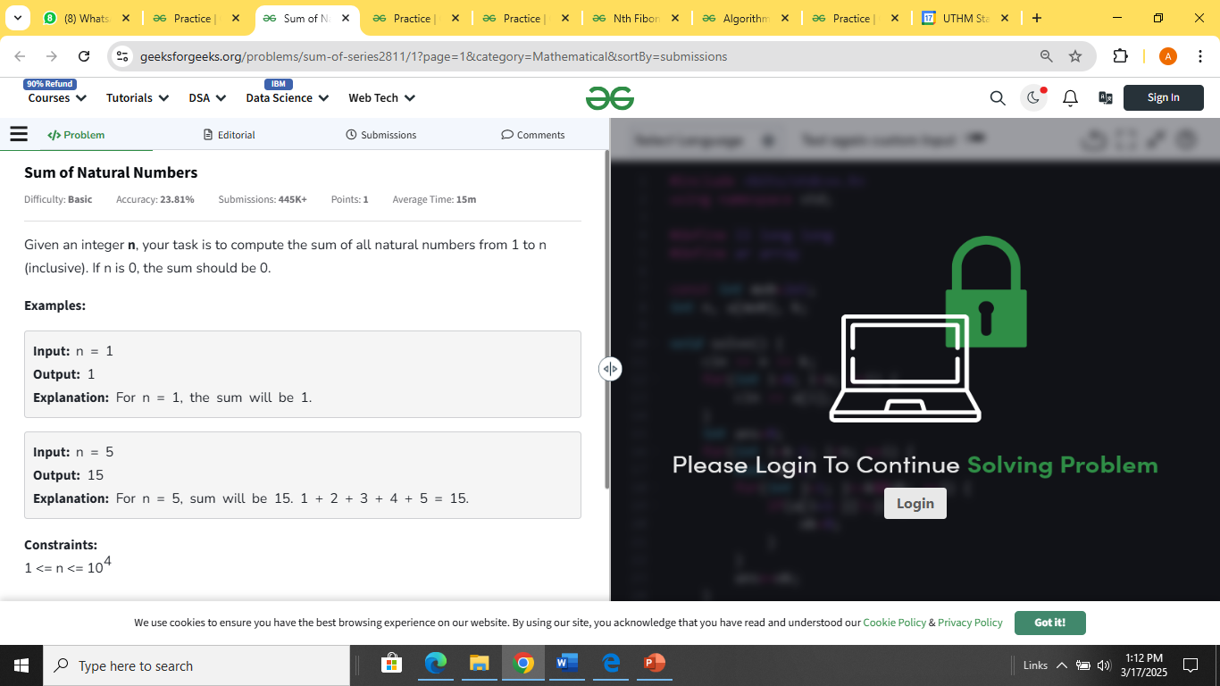
Activity
Based on this link:
https://www.geeksforgeeks.org/explore?page=2&category=Mathematical&sortBy=submissions&ref=taocp
Select 1 topic and try to solve it by using your basic programming skills. For example:
Share your result in the author in individual activity lecture week 1.

Slide 17
Thank You
ALGORITHM & COMPLEXITIES

